Slide 1
Android Programming Mobile Development
Dr Ian Drumm

Slide 2
User Interfaces
Aims:
Specify a user interface with XML and controlling from Java
Learning Outcomes:
XML
Graphic Layout
Set Content View
Find by ID

Slide 3
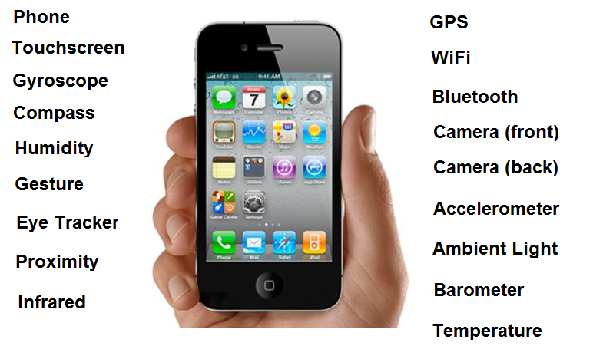

Review

Slide 4
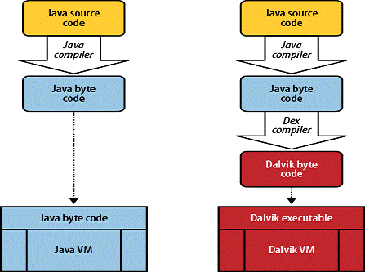
Review: Android Runtime Environment
Dalvik is the virtual machine used by Android
Though not JVM
Android SDK translates java bytecode to dalvik bytecode
ART is a new Android runtime being introduced in the 4.4 release

Slide 5

Review: Android Packages
Android Package File (.apk)
An .apk file contains all of that program's compiled code (dex files), resources, assets, certificates and manifest file.

Slide 6
What is XML?
XML is a universal standard for storing, organising, processing and communication of information.
XML is a primarily text based standard
Can be trusted to pass information through security firewalls via HTTP
HTML subset of XML
Underlying format for communication with Web Services
(e.g. SOAP, WSDL)

Slide 7
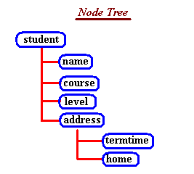
Save to file with .XML suffix
Hierarchical arrangement of elements each with a
start-tag and end-tag.
For example a root element
<NewDataSet> … </NewDataSet>
Sub elements
<student> ... </student>.
<address> …. </address>

Slide 8
Example XML contains student records.
<?xml version="1.0" encoding="utf-8" ?>
<NewDataSet>
<student>
<name>Fred Bloggs</name>
<course>MIT</course>
<level>2</level>
<address>
<termtime>21 Slum Rd, Salford</termtime>
<home>5 Posh Gardens, Bath</home>
</address>
</student>
<student>
<name>Bill Smith</name>
<course>MIT</course>
<level>2</level>
<address>
<termtime>15 Bog Terrace, Salford</termtime>
<home>17 Tidy Close, Cambridge</home>
</address>
</student>
</NewDataSet>

Slide 9
Elements can have attributes
For example
<StudentName first=”Fred” surname=”Bloggs”/>
is an alternative to
<StudentName>
<first>”Fred”</first>
<surname>Bloggs</surname>
</StudentName>

Slide 10
Creating a new Android Application
The method setContentView() can associate the user interface with XML
public class Hello extends Activity {
@Override
public void onCreate(Bundle savedInstanceState) {
super.onCreate(savedInstanceState);
setContentView(R.layout.main);
}
}

Slide 11
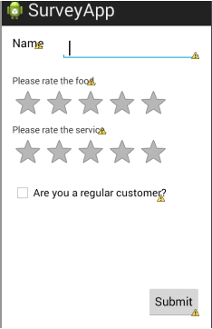
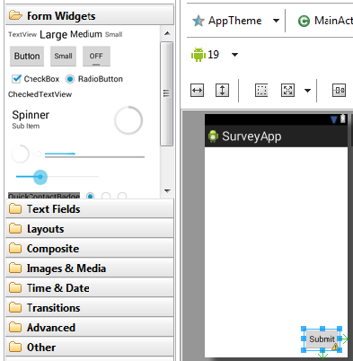
Building the user interface
Drag widgets into the design area

Slide 12
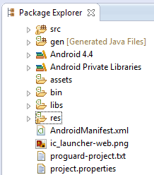
Important Directories
‘src’ folder
‘gen’ folder
automatically generated code
‘res’ folder

Slide 13

The ‘res’ folder
Subfolders
‘drawable’ … holds images such as the android icon
‘values’ … contains strings.xml
<string name="hello_world">Hello</string>
‘layout’ … contains activity_main.xml

Slide 14
Res/layout/main.xml
Specifies User Interface
<RelativeLayout xmlns:android="http://schemas.android.com/apk/res/android"
xmlns:tools="http://schemas.android.com/tools"
android:layout_width="match_parent"
android:layout_height="match_parent"
tools:context=".MainActivity" >
<TextView
android:id="@+id/textView1"
android:layout_width="wrap_content"
android:layout_height="wrap_content"
android:text="@string/hello_world" />
</RelativeLayout>

Slide 15
XML Namespace
E.g Namespace Uniform Resource Identifier (URI) is….
xmlns:android="http://schemas.android.com/apk/res/android"
Lets you see elements like: android:layout
Saves you from having to write in full…
http://schemas.android.com/apk/res/android:layout

Slide 16
Views and attributes
RelativeLayout is a layout container, and a root ‘view group’ specifying how child views will be laid out relative to each other
match_parent …sets the dimension to match that of the parent element.
wrap_content …sets the dimension only to the size required to fit the content of this element.
id … is the id of the view. Eg. android:id="@+id/textView1"
Text View is a child view
text …@string/hello_world specified in res/values/string.xml

Slide 17
When new widgets added
Attributes for relative positions
<Button
android:id="@+id/button1"
android:layout_width="wrap_content"
android:layout_height="wrap_content"
android:layout_alignLeft="@+id/textView1"
android:layout_below="@+id/textView1"
android:layout_marginTop="20dp"
android:text="Button" />

Slide 18


ConstraintLayout
Allows complex layouts with a flat view hierarchy (no nested view groups).
As with RelativeLayout views are laid out relative to other widgets
More flexible than RelativeLayout
Easier to use with Android Studio's Layout Editor
https://developer.android.com/training/constraint-layout/index.html

Slide 19
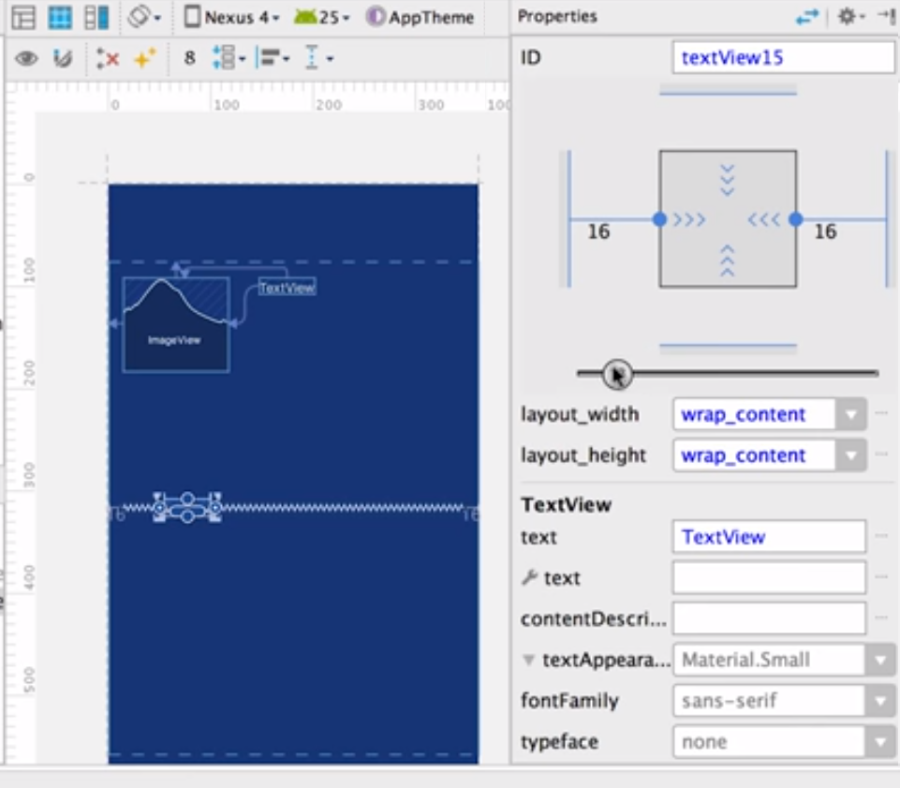
Constraining Views in UI
Anchor views to others or parent with constraints
Can set biases of constraints, to help position left and right within constraints
Can set size of view with ‘wrap content’, ‘fixed size’ or ‘match constraint’

Slide 20
gen/…/R.java
Auto generates ids for your resources
public final class R {
...
public static final class drawable {
public static final int ic_launcher=0x7f020000;
}
public static final class id {
public static final int textView1=0x7f080000;
}
public static final class string {
public static final int action_settings=0x7f050001;
public static final int app_name=0x7f050000;
public static final int hello_world=0x7f050002;
}
}

Slide 21
XML Widgets referenced as objects in Java Code
Using findViewById
TextView tv1;
tv1 = (TextView) findViewById(R.id.textView1);
tv1.setText(“hello again”);

Slide 22
Widgets and Objects
nameEditText = (EditText)findViewById(R.id.editText1);
foodRatingBar = (RatingBar)findViewById(R.id.ratingBar1);
serviceRatingBar = (RatingBar)findViewById(R.id.ratingBar2);
customerCheckbox = (CheckBox)findViewById(R.id.checkBox1);
submitButton = (Button)findViewById(R.id.button1);
listView=(ListView)findViewById(R.id.listView1);
Using findViewById

Slide 23
Widgets and Objects
String name = nameEditText.getText().toString();
float rating = foodRatingBar.getRating(),
boolean val = regularCustomerCheckbox.isChecked()
Reference can hence get or set widget values and properties

Slide 24
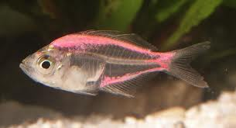

Anonymous Inner Classes definitions
f1 points to an instance of Fish
f2 points to a sub class of fish, we don’t know the class name (anonymous)
Fish f1= new Fish();
Fish f2= new Fish() {Jaws j;};

Slide 25
Anonymous Inner Classes definitions
Fish() {Jaws j;};
SomeClass() { code defining new class’s members }
Fish() {void swim() {x++}};
SomeInterface() { code implementing interface members }
An anonymous class can be a sub class
or a concrete realisation of an interface

Slide 26
Handling a button click event with Anonymous Class
The b1Listener object is an instance of an anonymous class that realises the OnClickListener interface
OnClickListener b1Listener= new OnClickListener() {
@Override
public void onClick(View v) {
tv1.setText("Button clicked");
}
};
b1.setOnClickListener(b1Listener);

Slide 27
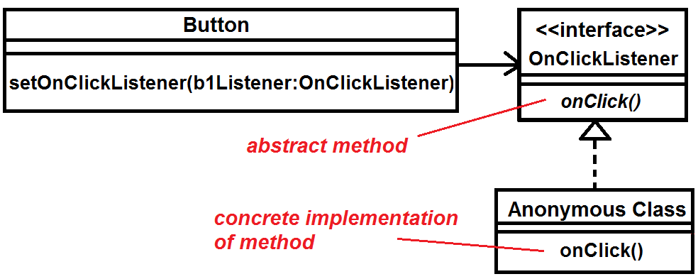
Event Handling
UML Class diagram of event handling

Slide 28
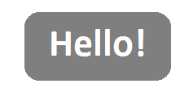
Toast
A toast is a view containing a quick little message for the user.
Where MainActivity.this is the current package context
Toast.makeText(MainActivity.this, "hello!", Toast.LENGTH_LONG).show();

Slide 29
Multiple Activities
An app can have multiple activities that get pushed onto or popped off an activity stack.
An ‘intent’ can be used to start another activity or enable communication between multiple activities
Here MainActivty in the current context, Main2Activity is the new activity you want to start.
You can go back to previous activity by calling ‘finish()’
Intent i1; // as field in MainActivity
// in onCreate method
i1 = new Intent(MainActivity.this,Main2Activity.class);
startActivity(intent1); // in event handler

Slide 30
Passing Values between Activities
You can send ‘extras’ (e.g. strings, ints, doubles, arrays, etc) to pass values between activities.
For example within MainActivity
And in Main2Activity
int val=123; intent1.putExtra("MyVariableName",val);
Bundle extras = getIntent().getExtras(); if(extras!=null) { int val=extras.getInt("MyVariableName"); Toast.makeText(Main2Activity.this, "val="+val, Toast.LENGTH_LONG).show(); }

